Slide 1





Critical Reading
Exam
Gu, J., Jiang, X., Shi, Z., Tan, H., Zhai, X., Xu, C., Li, W., Shen, Y., Ma, S., Liu H., Wang, S., Zhang, K., Lin, Z., Zhang, B., Ni, L., Gao, W., Wang, Y., & Guo, J. [3]. A Survey on LLM-as-a-Judge. The Innovation, 101253. DOI:
10.1016/j.xinn.2025.101253, 2026
03.06.2026 | Stergios Konstantinidis

Slide 2
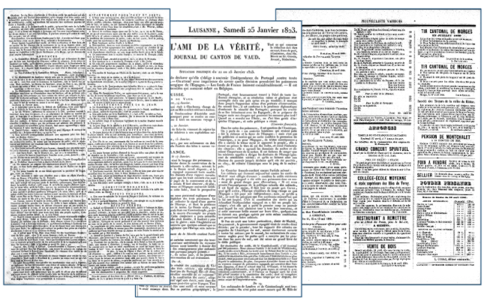
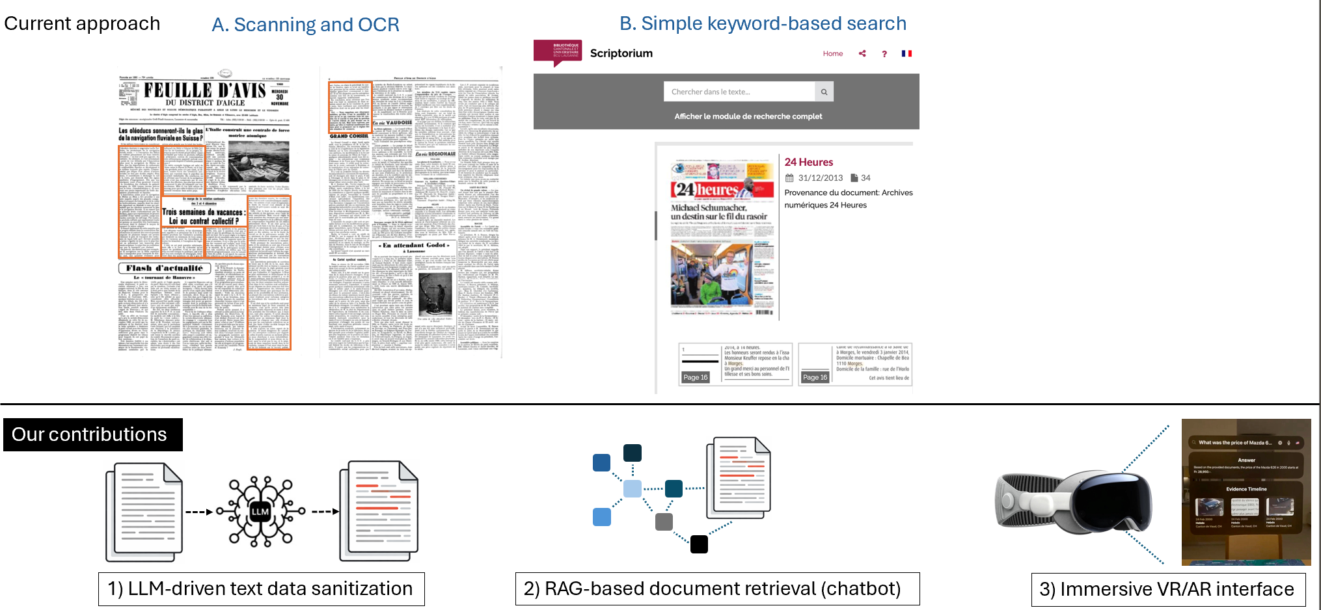
Definitions| What is LLM as a judge
Core idea
Concrete examples
Simulate human Judgment using LLMs
Lower costs in both time and money
Facilitate experimentation in different situations

Slide 3
Motivation| LLM as a judge can benefit everyone in our department (and beyond)
In many instances…
…we can use LLM as a judge
Analyse user studies (e.g., interviews, user forms)
Algorithms/pipelines (e.g., Information retrieval, pipelines)
Bias understanding (e.g., how does one person's perspective differ from someone else’s)
Information retrieval (e.g., company data, user posts)
Select
(e.g., Follow up questions, insights)
Score
(e.g., Performance metrics)
Classify
(e.g., Biased/Unbiased, Propaganda…)
Compare
(e.g., Which document is most relevant, is it found or not…)

Slide 4
Summary| The article Explores what LLM as a judge is and different steps in an implementation
Survey design
In this Survey, the authors explore…
How to use
How to improve
How to evaluate
Applications
Challenges
Future work

Slide 5
Summary| How does the paper approach the lifecycle of LLM as a judge
Findings along three key steps
How to use
Getting started
In order to successfully implement an LLM as a judge one needs to…
Identify the target to measure (model, data, agents, reasoning?) Define clear reliability metrics, select a model carefully, as well as a prompt/context.
Structure your experiment around LLM as a judge, expect an iterative effort
1
How to improve
Common tricks
2
How to evaluate
Validation
3
Gu et al. (2026, p. 2-8)

Slide 6
Summary| How does the paper approach the lifecycle of LLM as a judge
Findings along three key steps
How to use
Getting started
Adjust prompt to content to be evaluated
Specify key elements
Check whole logic
Decompose evaluation criteria
Instead of "which of these items is best" rank each individually then identify best
Use meta evaluation
Few shot prompting
Add relevant documents (GS)
etc...
1
How to improve
Common tricks
2
How to evaluate
Validation
3
Gu et al. (2026, p. 8-12)

Slide 7
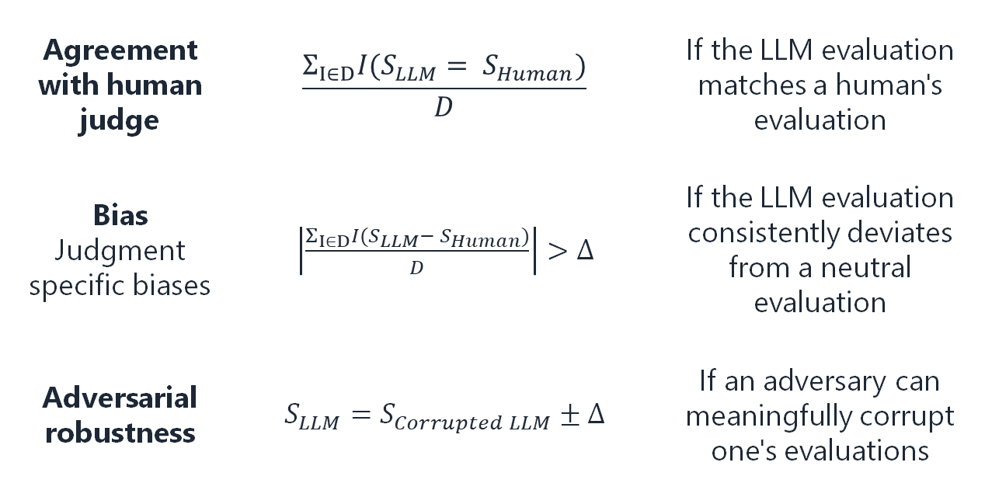
Summary| How does the paper approach the lifecycle of LLM as a judge
Findings along three key steps
How to use
Getting started
1
Agreement with human judge | $$\frac{Σ_{I∈D}I(S_{LLM}= S_{Human})}{D}$$ | If the LLM evaluation matches a human's evaluation
Bias Judgment specific biases | $\left|\frac{Σ_{I∈D}I(S_{LLM}− S_{Human})}{D}\right|>Δ$ | If the LLM evaluation consistently deviates from a neutral evaluation
Adversarial robustness | $$S_{LLM}=S_{Corrupted LLM}±Δ$$ | If an adversary can meaningfully corrupt one's evaluations
How to improve
Common tricks
2
How to evaluate
Validation
3
Gu et al. (2026, p. 13-14)
Notes:
$$\frac{Σ_{I∈D}I\sim (S+Δ>S_{LLM}>S−Δ)}{D}$$

Slide 8
Summary| How does the paper approach the Applications and Challenges
Critical decision making
reviewing patient data or approving financial decisions
Review specific applications
LLM reviewer #2
Creative applications
evaluate viability of creative ideas
Bias amplification
Impact on creative and diverse outputs
Lack of accountability
Risk of adversarial input (high damage potential)
Input sensitivity
Lack of domain specific knowledge
Gu et al. (2026, p. 16-22)

Slide 9
Strenghts| What this paper did well
Approaching the subject
The authors create a highly accessible roadmap for both academics and practitioners.
AI bias analysis
It distinctly separates "task-agnostic biases” from "judgment-specific biases"
Formalization
Formal definition of the "LLM-as-a-judge" process, encapsulated as
$$ℛ←f_{ℝ} (P_{Cℳℳ},x,C)$$
Notes:
It distinctly separates "task-agnostic biases" (e.g., cultural or diversity biases inherent to foundation models) from "judgment-specific biases" (e.g., position bias, length bias, and compassion-fade bias triggered specifically in evaluation setups).

Slide 10
Limitations| The paper needs to be interpreted considering the key limitations in the definition, methodology, and presentation
Definition
Methodology
Meta-evaluation
Context
The paper aims to standardise the terminology around LLM-as-a-Judge
The authors compare performance across models/setups
The paper aims to “evaluate the evaluator”
Creating confusion between ideas and effective implementations
The comparison utilises closed source obsolete model's vs low tier open-source models
The paper struggles to provide a scalable solution that does not fall back on human annotation.
Limitation
Multi-LLM vs LLM voting
Prompt train data/in context learning vs Few shot prompting/prompt engineering
Use of GPT-3.5 (2022) and Qwen 2.5 7b (2024)
Examples
Notes:
Definitions:
Multi-LLM = voting system
Prompt train data/in context learning = Few shot prompting
in context learning in text and Prompt train data in figure
Figure one shows a section that does not exist, also mentioned in the intro, BUT IT IS NOT THERE

Slide 11
Relevancy| In my dissertation, the article is relevant in two key ways
1
Using the findings…
…to better evaluate our pipeline across different steps, and allow for a faster and more reliable iteration process
2
…to align our evaluations with academic and practitioner metrics more thoroughly

Slide 13

Teaser| A preview of what my research is on

Slide 14
Motivation| LLM as a judge can benefit everyone in our department (and beyond)
In many applications…
…we can use LLM as a judge!
Select
(e.g., Follow up questions, relevant answers)
Score
(e.g., Performance metrics)
Classify
(e.g., Biased/Unbiased, Propaganda…)
Compare
(e.g., Where is there relevant data, comparison amongst users)
User studies (e.g., conducting interviews, user forms)
Algorithms/pipelines (e.g., RAG pipelines)
Bias understanding (e.g., how does one persons perspective differ from someone else’s)
Unstructured data management (e.g., company data review, analysis of user posts)

Slide 15
Motivation| LLM as a judge can benefit everyone in our department (and beyond)
In many instances…
…we can use LLM as a judge
Analyse user studies (e.g., interviews, user forms)
Algorithms/pipelines (e.g., RAG pipelines)
Bias understanding (e.g., how does one person's perspective differ from someone else’s)
Unstructured data management (e.g., company data review, analysis of user posts)
Select
(e.g., Follow up questions, insights)
Score
(e.g., Performance metrics)
Classify
(e.g., Biased/Unbiased, Propaganda…)
Compare
(e.g., Where is there relevant data, comparison amongst users)

