Slide 1
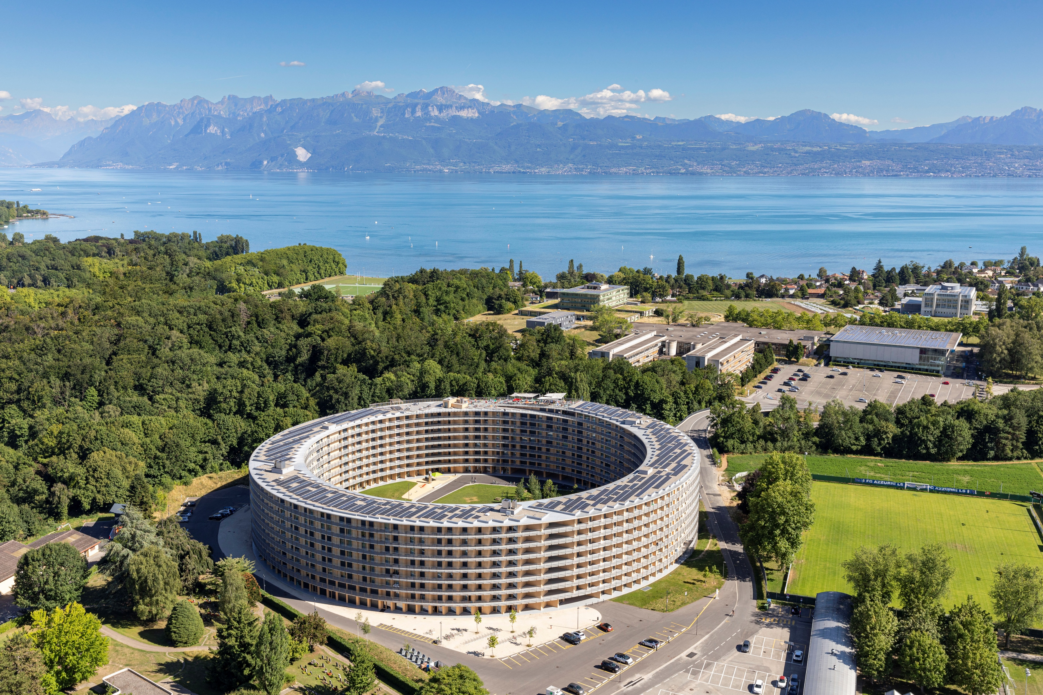

Cost-Aware Human-LLM Collaboration for Post-OCR Corrections in Swiss Historical Newspapers
DocEng26
28.08.2026 | Stergios Konstantinidis| Hayman Lotfy | Prof. Michalis Vlachos

Slide 2



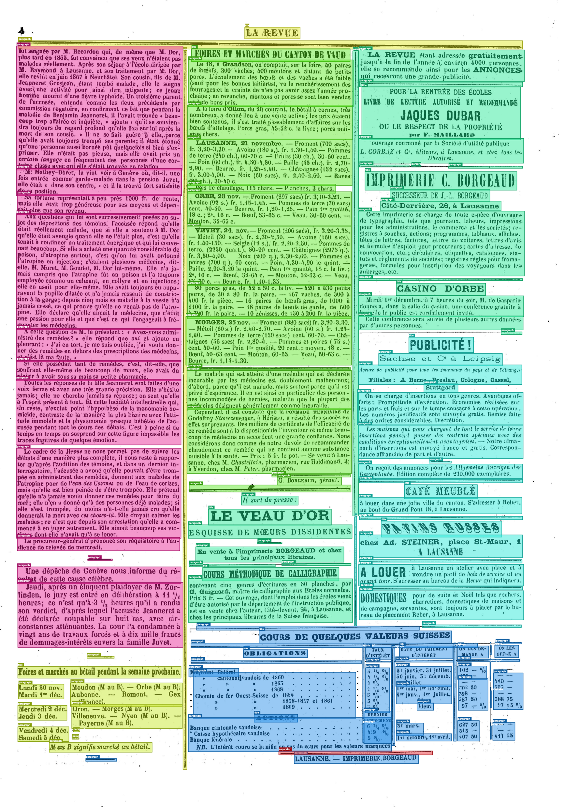
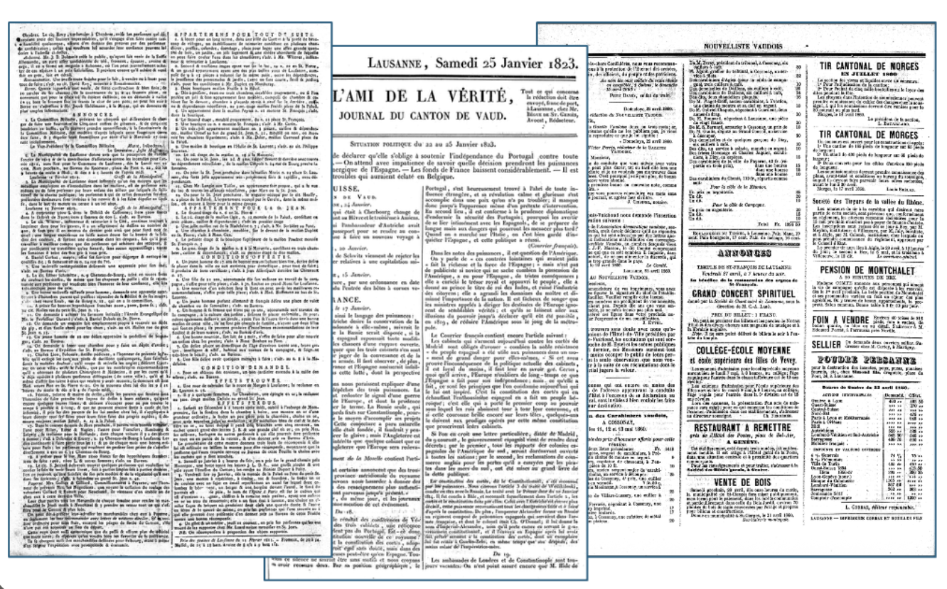
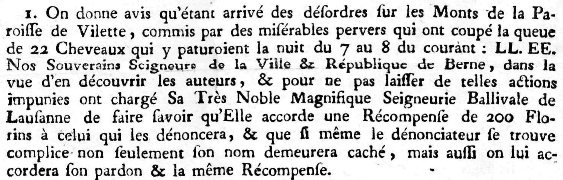
Motivation| We are working on RAG systems for information retrieval over | historical archives...
Meet our data:
Thousands of newspaper issues spanning over 300 years
Millions of pages
12 tb of raw images –> 1 image = 1 page

Slide 3
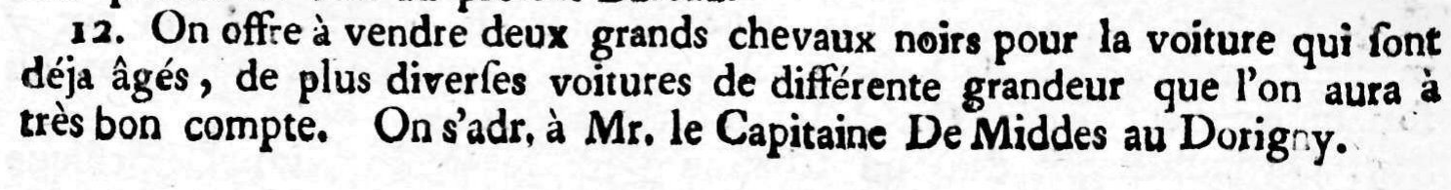
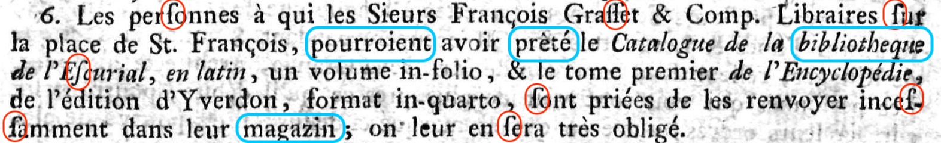
Motivation| Why document cleaning is not always straightforward | An OCR text corrector use-case
Post-OCR text correction is an essential step to improve the quality of our corpus
Traditional correction tools often neglect linguistic shifts
12. On offre à vendre deux grands chevaux noirs pour la voiture qui sont
déjà agés, de plus diverses voitures de différente gradeur que l’on aura à
très bon compte. On s’adr. à Mr le Capitaine De Middes a Dorigny.
6. Les personnes à qui les Sieurs François Grasset & Comp. Libraires sur
la place de St. François, pourraient avoir prêté le Catalogue de la bibliothèque
de l’Escurial, en latin, un volume in-folio, & le tome premier de l’Encyclopedie,
de l’édition d’Yverdon, format in quarto, sont priées de les renvoyer inces-
samment dans leur magasin; on leur en sera très obligés

Slide 4
Motivation| Different segments benefit differently by text corrections
Segment B
Corrections: 8
Overcorrections: 2
CER improvement: 0.6%
Segment D
Corrections: 1
Overcorrections: 10
CER improvement: -3%
Segment A
Corrections: 4
Overcorrections: 1
CER improvement: 0.3%
Segment C
Corrections: 12
Overcorrections: 0
CER improvement: 2%
Segment E
Corrections: 4
Overcorrections: 1
CER improvement: 1.5%

Slide 5
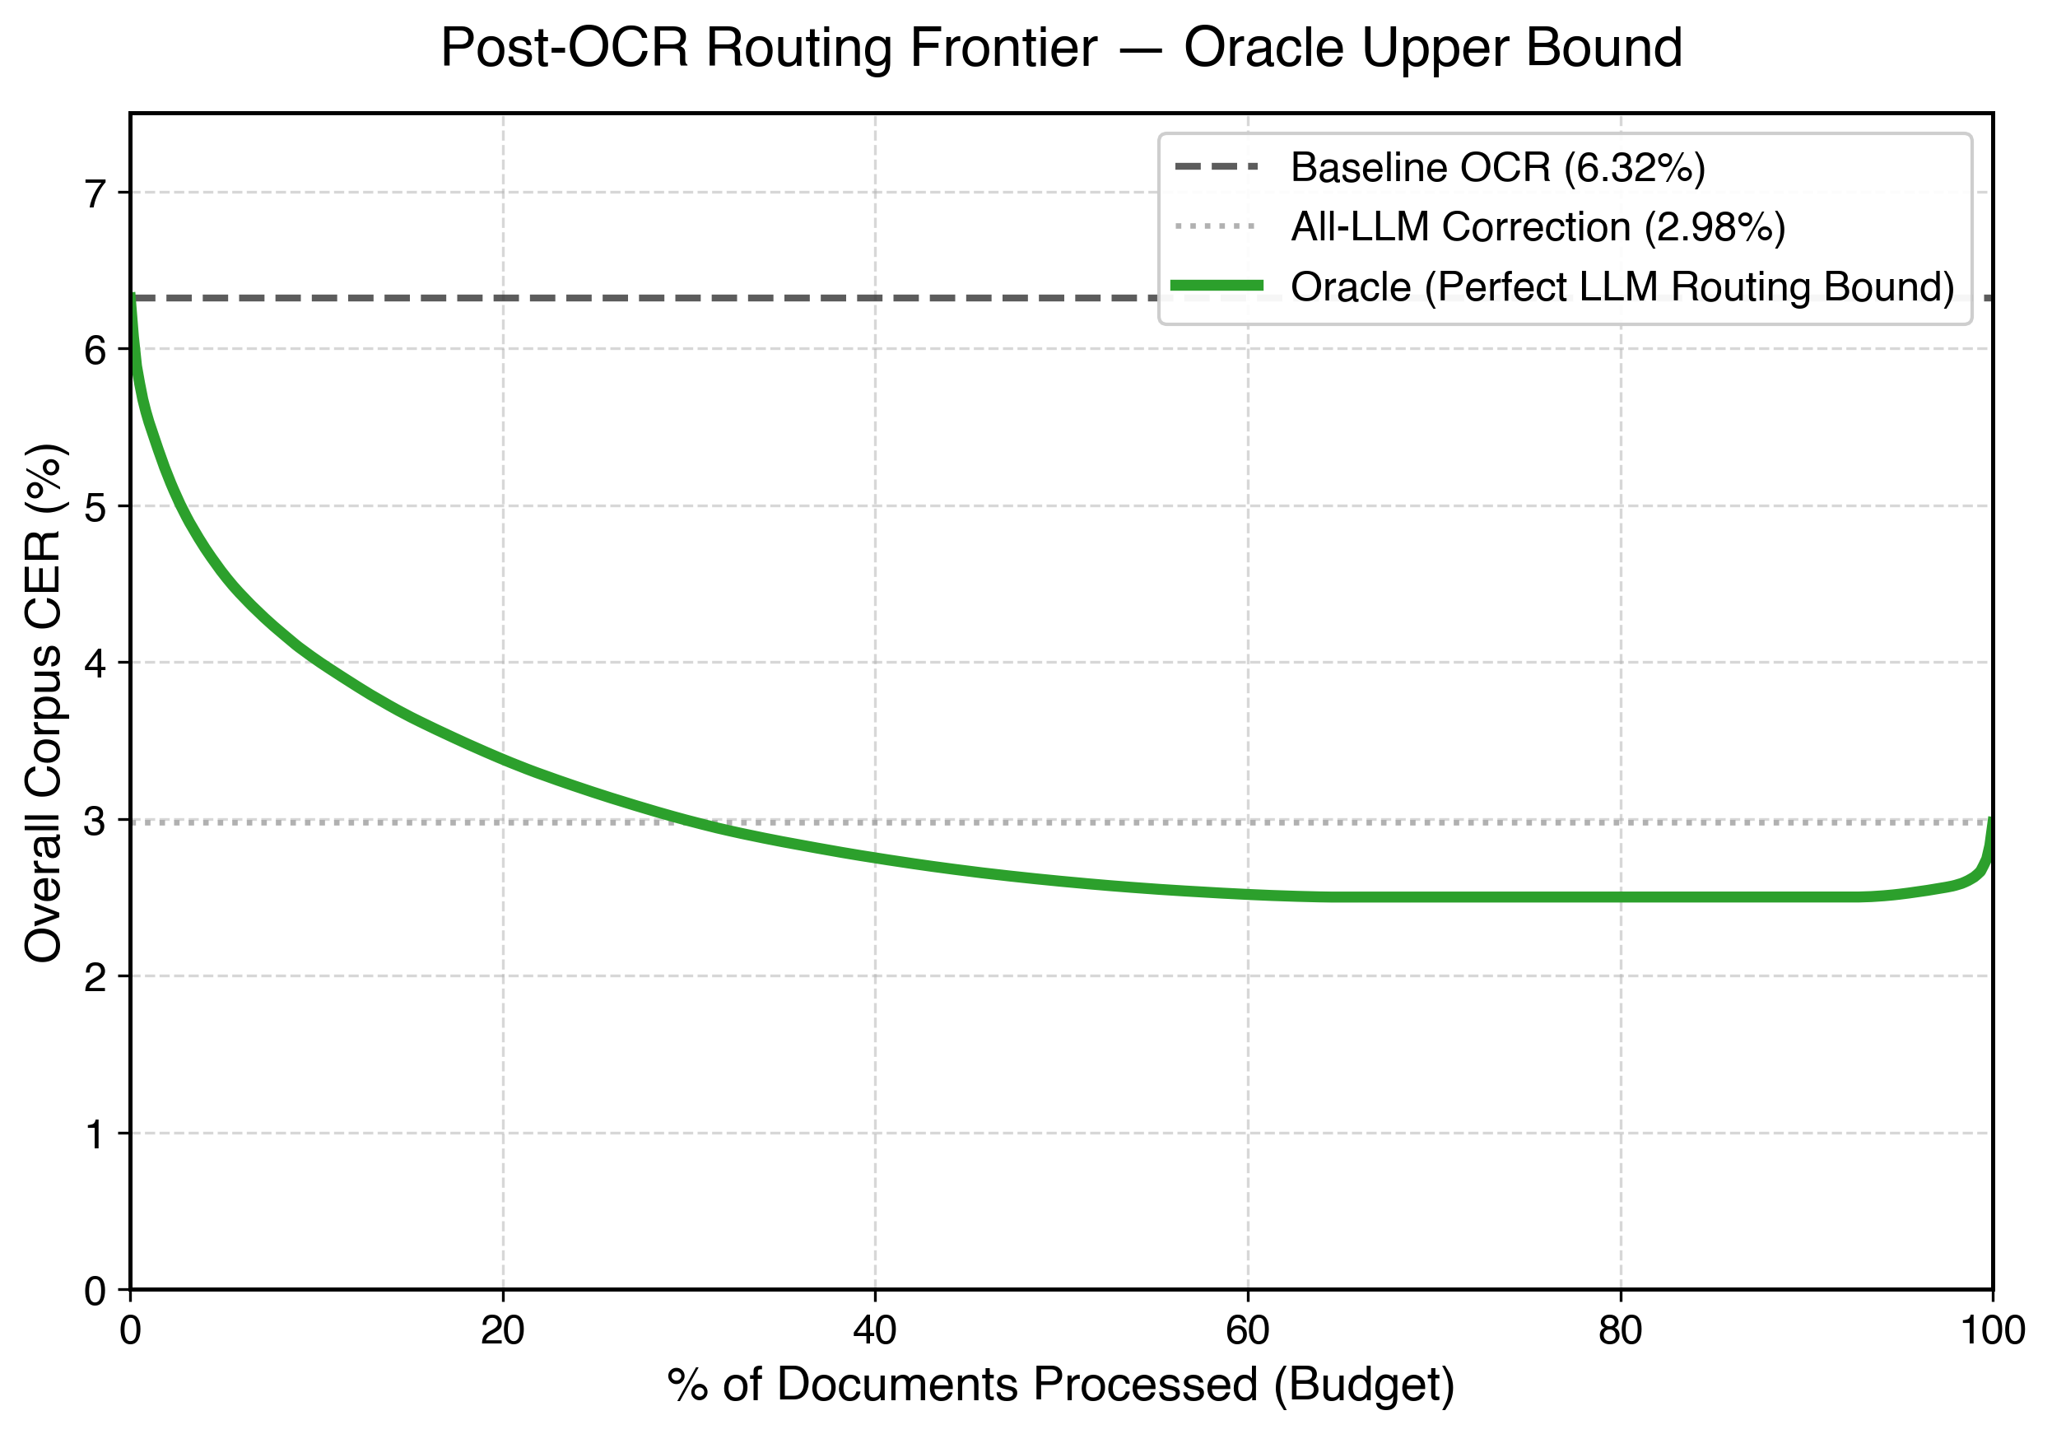
Motivation| Assume we know in advance the documents that would benefit | most by being corrected:

Slide 6
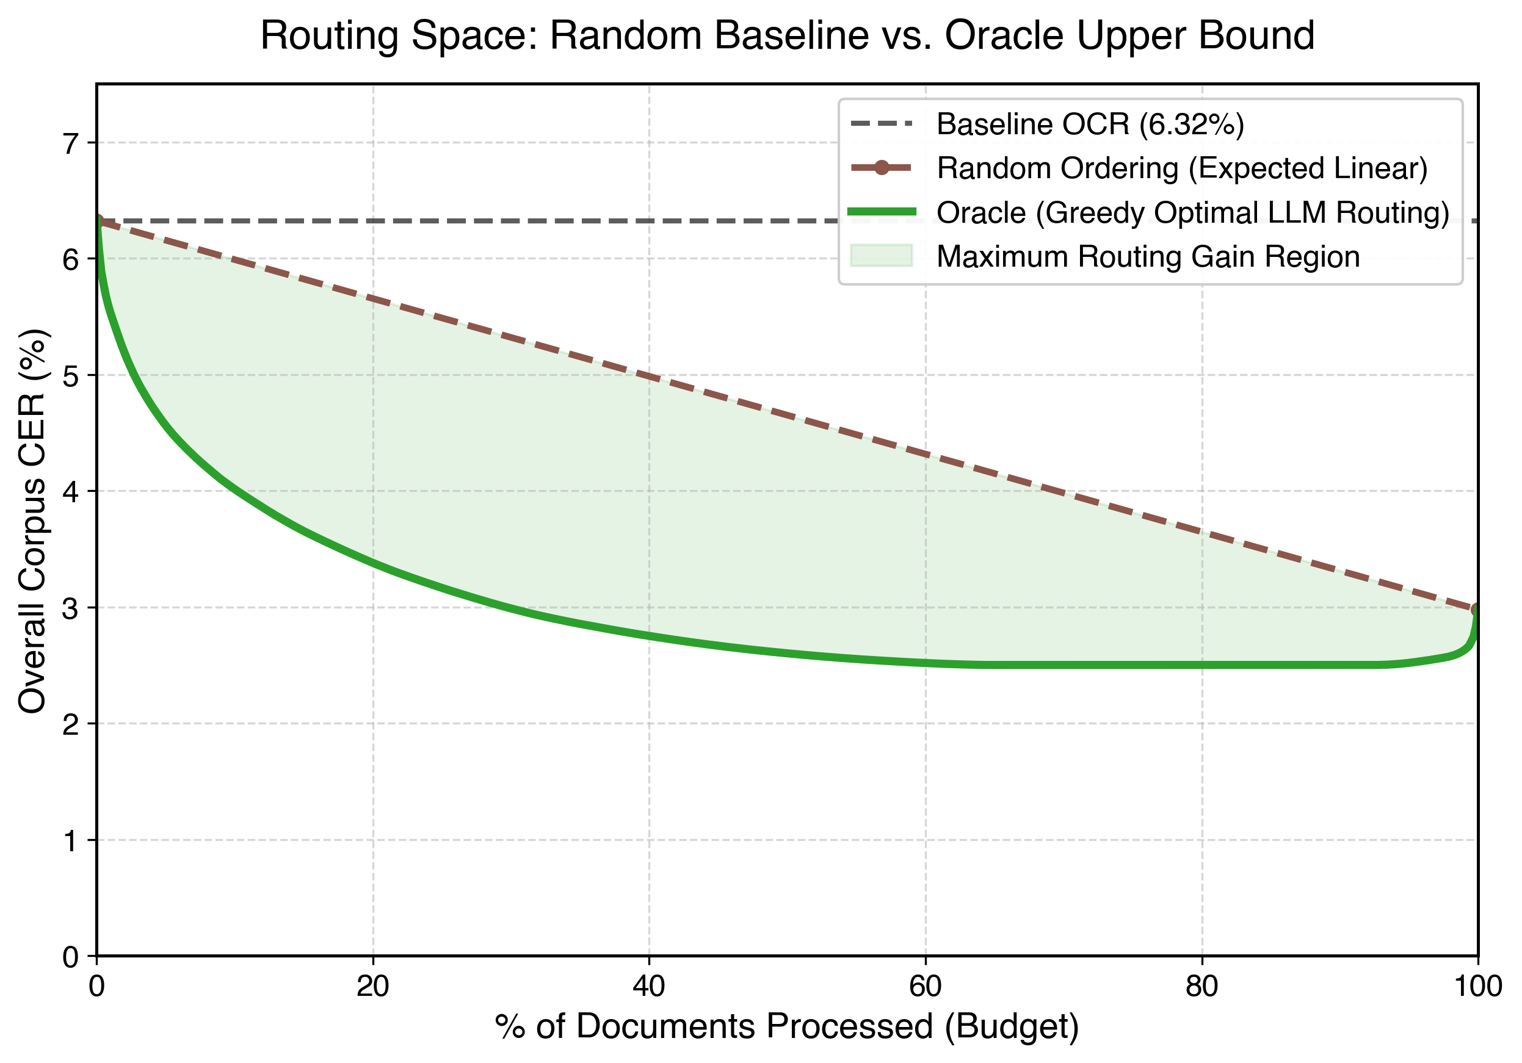
Motivation| Assume we know in advance the documents that would benefit | most by being corrected: In reality we don’t know the right order!
If we don’t know the right order to correct, correcting all documents makes sense!

Slide 7
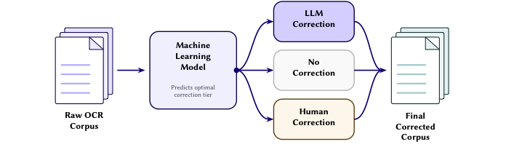
Our contribution| What if we knew the right order in which to correct the | documents?
Implementation:
Router
Router that evaluates the potential improvement that may be offered by LLM corrections.
  If LLM correction is sufficient -> route to LLM
  Elif too complex -> human review
  Else leave the segment alone

Slide 8
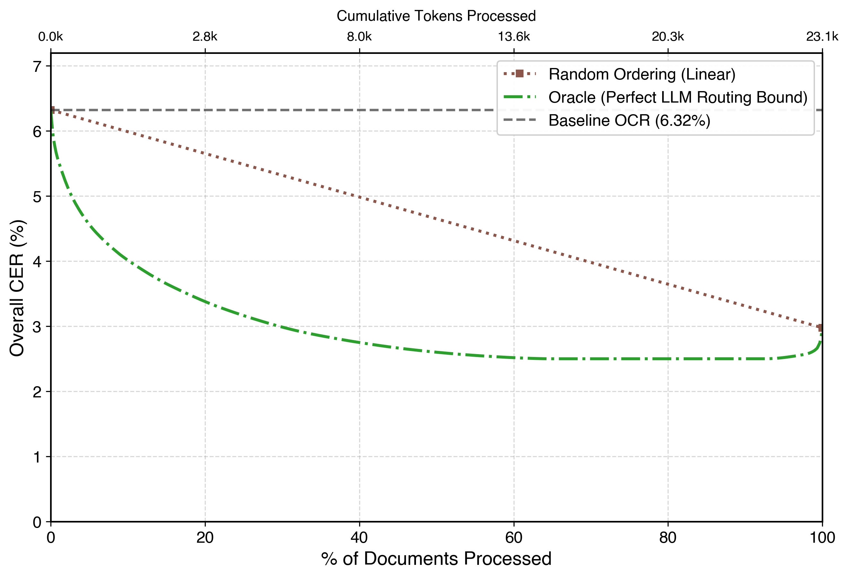
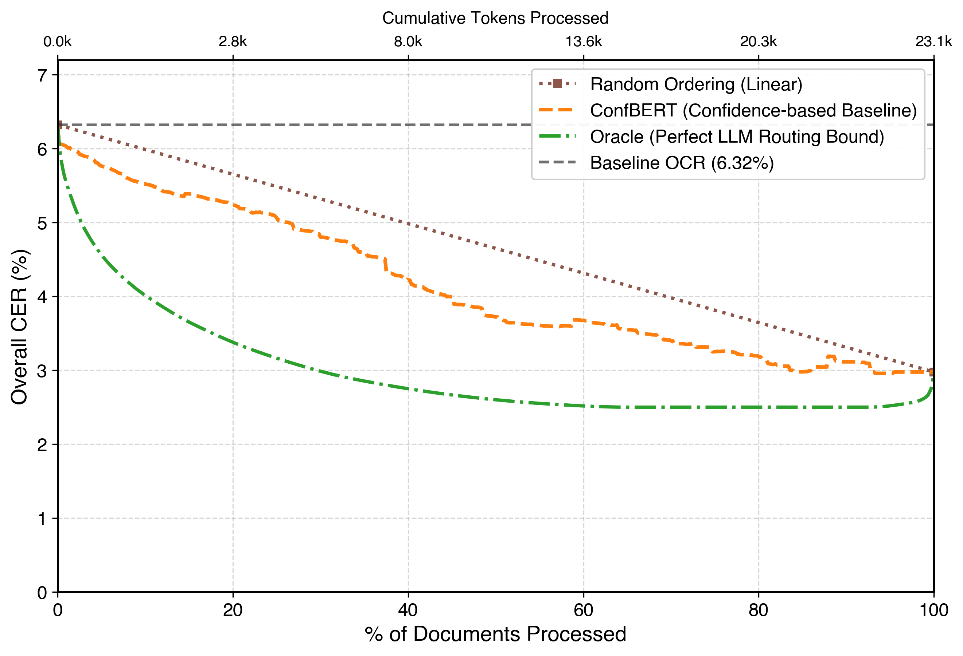
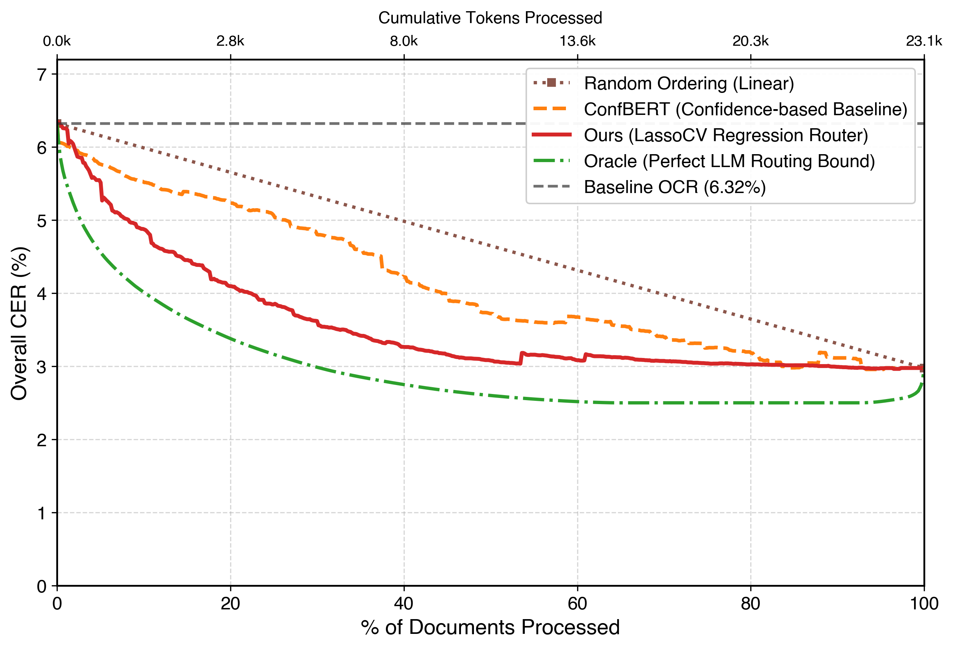
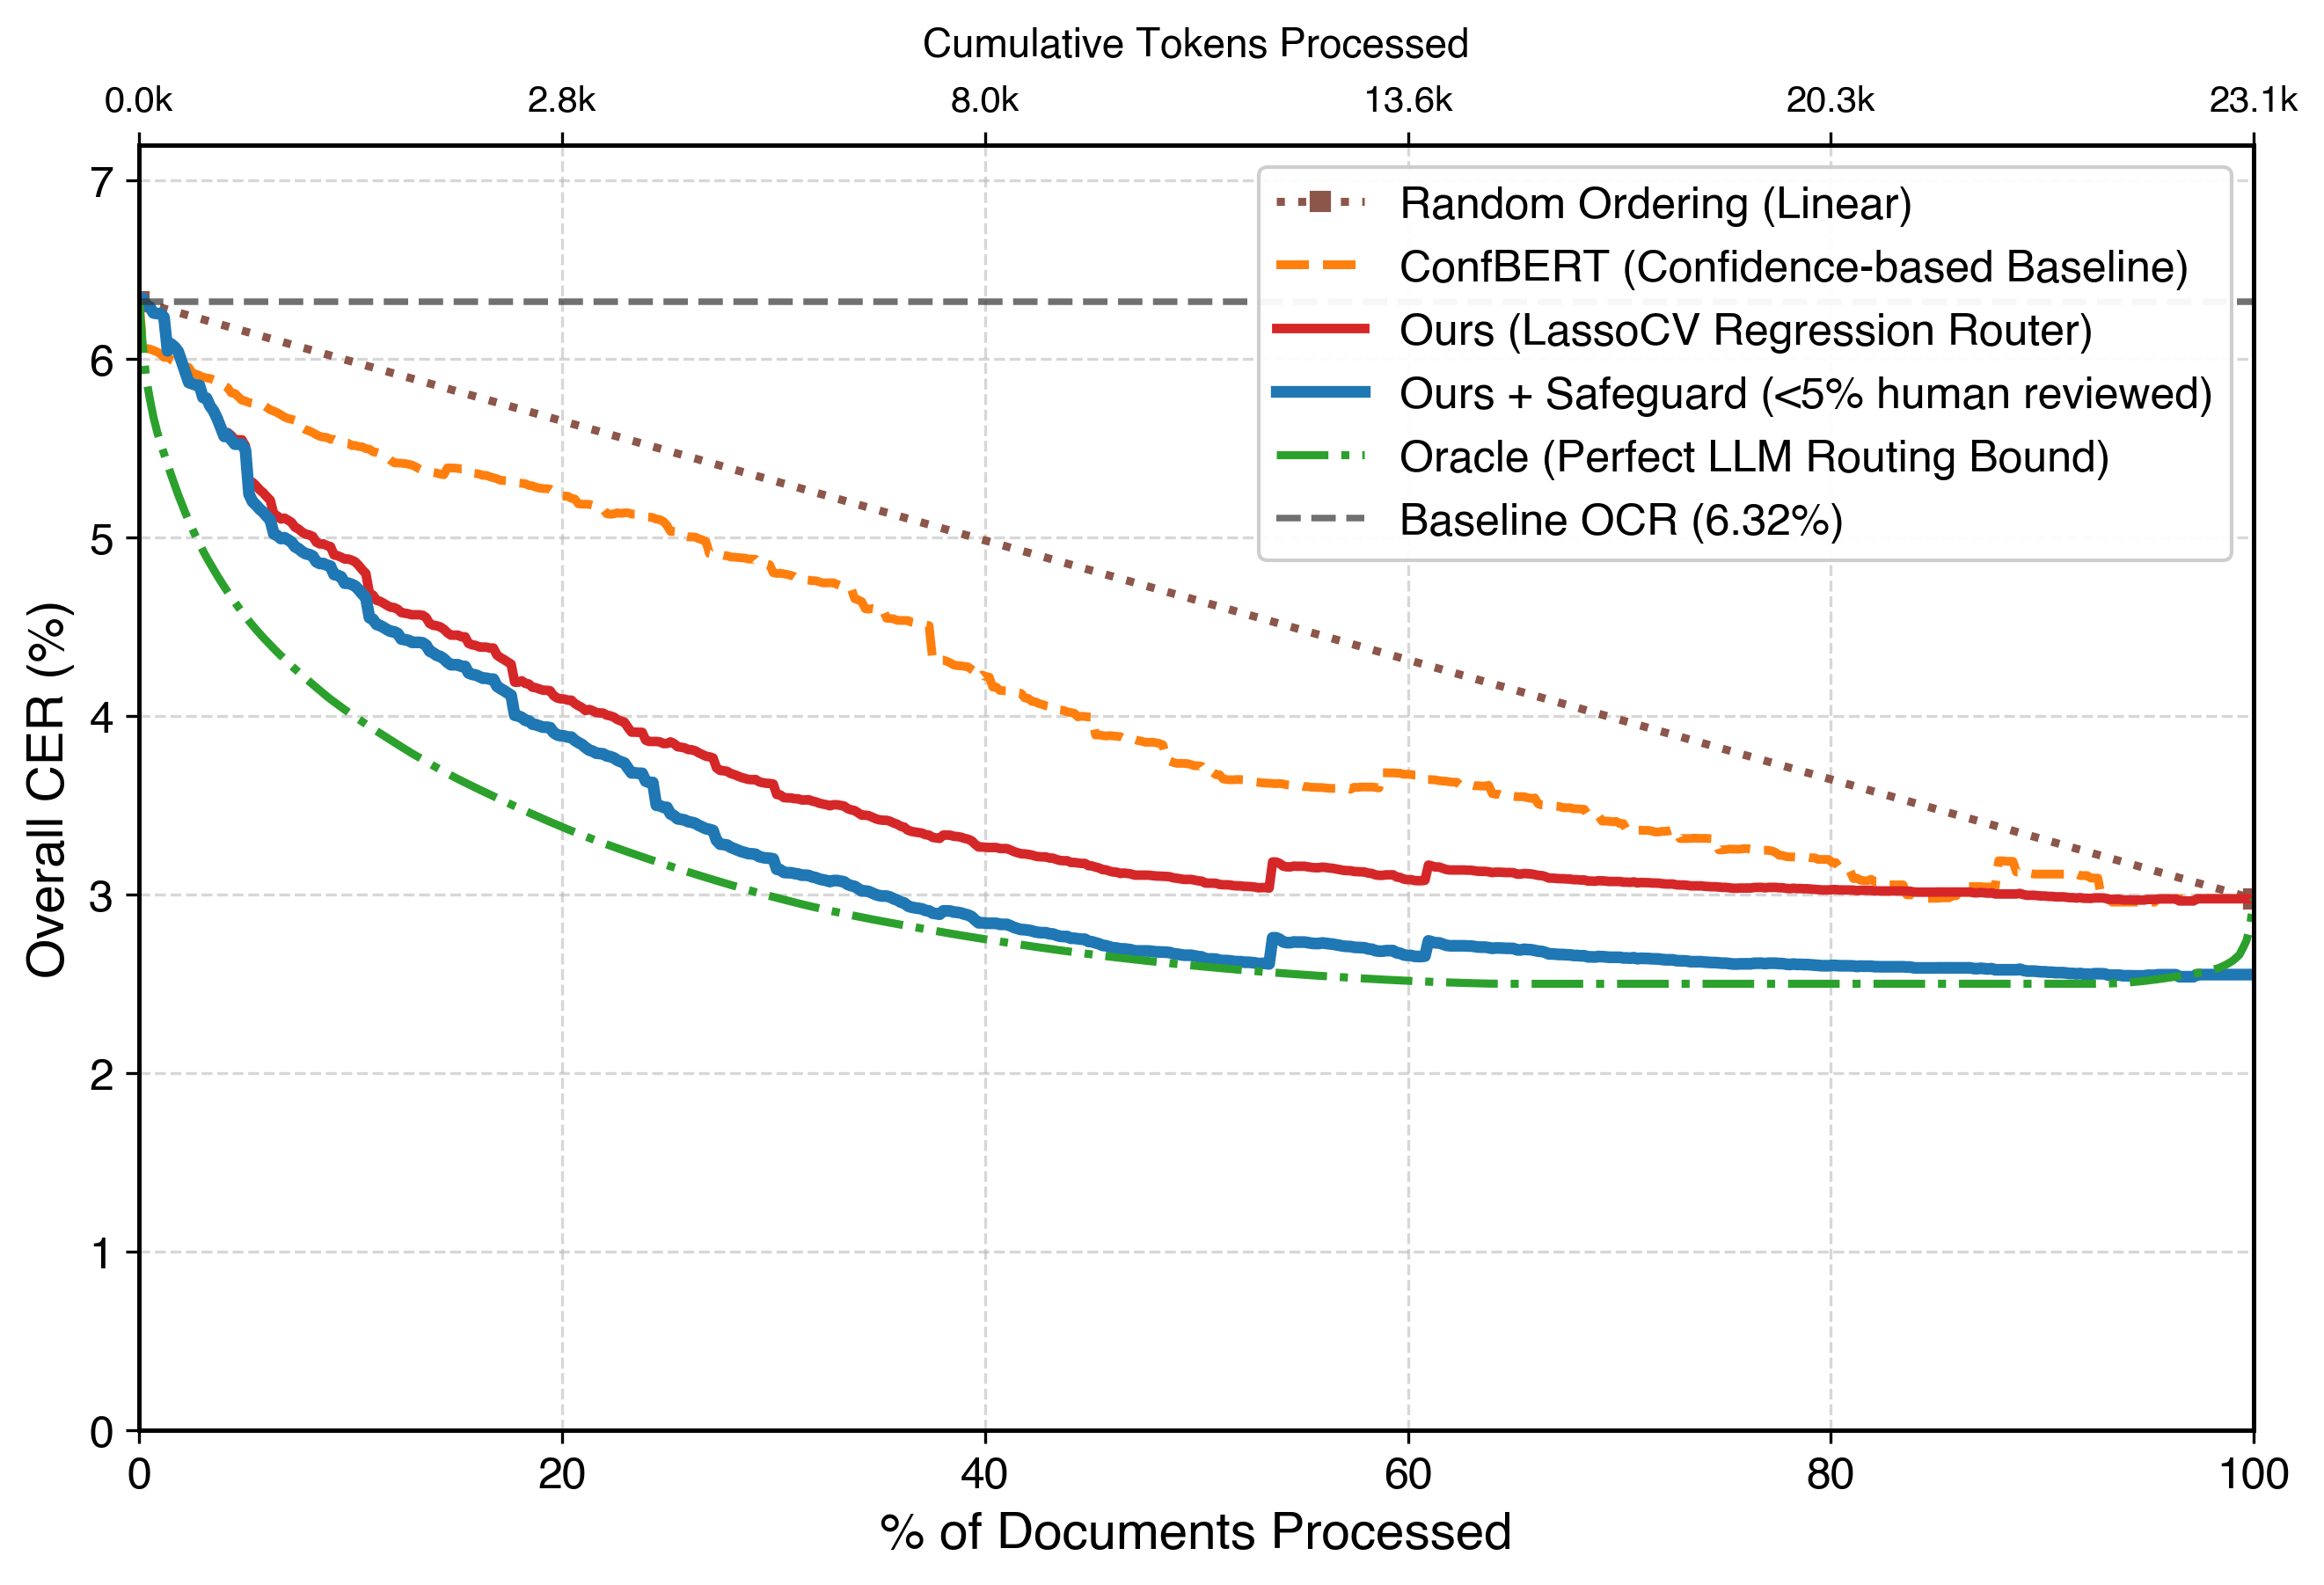
Results| How well does our model perform?

Slide 9
Summary | Key takeaways from our paper
Research Streams
Key contributions
Cost saving in tokens
40% reduction in correction effort
Setup cost is negligible
we reuse the evaluation dataset for
Human guardrail
We can effectively identify elements that require human attention, when LLM’s are insufficient
Scaling to other datasets
We could imagine a world where the human is replaced by other, rule-based methods.

Slide 10


Get in touch!

